Slide 1
The Limits to Growth: Sustainability and the Circular Economy
Lecture 3: Introduction III – Resources and Environmental Pollution
Prof. Dr. Benjamin Leiding
M.Sc. Anant Sujatanagarjuna

Slide 2
License
This work is licensed under a Creative Commons Attribution-ShareAlike 4.0 International License. To view a copy of this license, please refer to https://creativecommons.org/licenses/by-sa/4.0/ .
Updated versions of these slides will be available in our Github repository.

Slide 3
Updated BBB Links
We have to update the BBB links → please check your emails, the course website or the slides on Github before the next lecture.

Slide 4
Course Organization
Course website – Link
News and updates:
CLZ students + DigiTec: StudIP (Link)
Everyone else: Mailing list (Link)
Slides will be uploaded to StudIP (Link) and to Github (Link)
Please report bugs ;)
Lecture recordings will be available on StudIP and on Github
Questions? Write us an email: etce-ltg@tu-clausthal.de ← We will only respond to emails written to this specific email address!

Slide 5
Bonus Task
Project Registration
Bonus task:
Form groups of 2 or more people
Come up with a great idea that revolves around sustainability in general
Push the idea as far as possible throughout the semester
Record a 60s video explaining your idea and what you did throughout the semester
Selection of the 5 best ideas → bonus points for the exam (e.g., better grade – instead of 2.0 → 1.7 or something similar)
More info on points, percentages, etc. follow on the next slides (Examination)

Slide 6
Bonus Task
Project Registration
Project registration deadline: 15.05.2022
How do I register?
Form groups of 2 or more people
Come up with a great idea that revolves around sustainability in general
Write us an email (etce-ltg@tu-clausthal.de) that contains:
Team name
Short description (2-5 sentences) of your idea
Team members

Slide 7
Updates
Earth Overshoot Day 2022 (Germany)
04.05.2022
Assuming that everyone on Earth lives according to our (German) standard of living → How many Earths do we need?
https://www.overshootday.org/newsroom/country-overshoot-days/

Slide 8
E01 – Your Personal Carbon Footprint

Slide 9
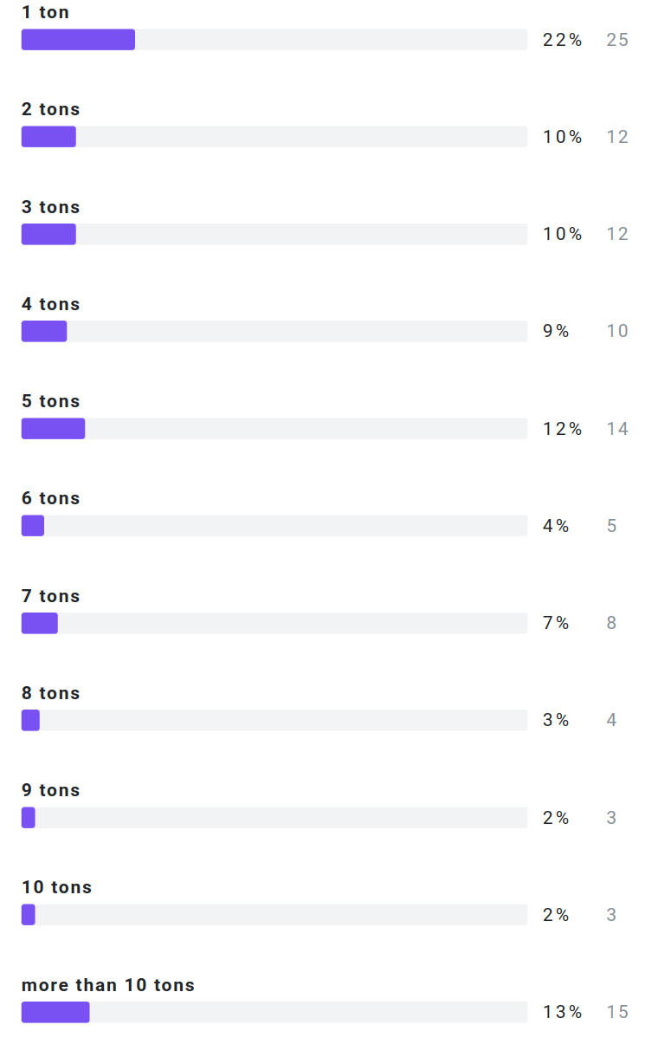
Your Personal Carbon Footprint
Results E01

Slide 10
Your Personal Carbon Footprint
Problem already solved?
So we just reduce our CO2 footprint and we are good?

Slide 11
Your Personal Carbon Footprint
Microsoft will be Carbon Negative by 2030
“By 2030 Microsoft will be carbon negative, and by 2050 Microsoft will remove from the environment all the carbon the company has emitted either directly or by electrical consumption since it was founded in 1975.”
https://blogs.microsoft.com/blog/2020/01/16/microsoft-will-be-carbon-negative-by-2030/

Slide 12
Your Personal Carbon Footprint
Apple will be Carbon Neutral by 2030
“Apple today unveiled its plan to become carbon neutral across its entire business, manufacturing supply chain, and product life cycle by 2030. The company is already carbon neutral today for its global corporate operations, and this new commitment means that by 2030, every Apple device sold will have net zero climate impact.”
July 2020
https://www.apple.com/newsroom/2020/07/apple-commits-to-be-100-percent-carbon-neutral-for-its-supply-chain-and-products-by-2030/

Slide 13
Your Personal Carbon Footprint
Polestar – 2030 Climate-neutral Car
“...we’re embarking on our greatest journey so far: challenging ourselves to create a climate-neutral car by 2030, by reducing emissions throughout supply chain and production.”
https://www.polestar.com/uk/news/striving-for-zero-the-2030-climate-neutral-car-plan/

Slide 14
Your Personal Carbon Footprint
Polestar – 2030 Climate-neutral Car
“...we’re embarking on our greatest journey so far: challenging ourselves to create a climate-neutral car by 2030, by reducing emissions throughout supply chain and production.”
“Relying on the current trend of offsetting by planting trees is not sustainable in the long run. It would mean using too much land, and the long-term carbon-storage capacity of forests and soils is not well known. Offsetting by planting trees also risks contributing to monocultures and loss of biodiversity. Additionally, there can be no guarantee that a forest won’t later be logged, devastated by a forest fire or altered by climate change.”
https://www.polestar.com/uk/news/striving-for-zero-the-2030-climate-neutral-car-plan/

Slide 15
Your Personal Carbon Footprint
Problem already solved?
It is not only about CO2…

Slide 16
Your Personal Carbon Footprint
Greenwashing?
Apple iPad Pro 11” 2018 | Gobs of adhesive hold most everything in place, making all repairs more difficult. The battery is secured with both easier-to-remove stretch-release tabs and conventional, non-removable adhesive. The USB-C port is modular and can be independently replaced.
Microsoft Surface Pro 6 2018 | All repairs require first removing the display assembly—which is stubbornly glued in place, expensive, and prone to shattering. The battery is firmly glued in place, with its connector pinned under the motherboard—requiring near-total disassembly for service. Once upon a time, Surface Pro storage was removable—but not in this version.
Apple iPad Air 3 2019 | Battery replacement is possible, but still unnecessarily difficult. Gobs of adhesive hold many parts and cables in place, complicating all repairs. Many components are modular and can be replaced independently, but the Lightning port is soldered to the logic board.
Apple iPad 7 2019 | As with all iPads, a solid barrier of very strong adhesive hinders all repairs. The Lightning port, a common point of failure, is soldered to the logic board. More adhesive holds nearly everything else in place. Battery and logic board replacements are particularly obnoxious.
Apple iPad Mini 5 2019 | Battery replacement is possible, but still unnecessarily difficult. Gobs of adhesive hold many parts and cables in place, complicating all repairs. Removing the home button is tough, and will be required for display replacement if you want to keep Touch ID functionality.
https://www.ifixit.com/tablet-repairability

Slide 17
Sustainability

Slide 18
Ecological Footprint
Definition
„The ecological footprint for a particular population is defined as the total area of
productive land and water ecosystems required to produce sufficient resources and assimilate wastes”
1.) W.E. Rees (1992) – Ecological footprint and appropriated carrying capacity: what urban economics leaves out. Environmental Urbanization.
2.) W.E. Rees, M. Wackernagel (1994) – Ecological footprints and appropriated carrying capacity: measuring the natural capital requirements of the human economy.
3.) D. Yue, J. Guo, C. Hui (2013) – Scale dependency of biocapacity and the fallacy of unsustainable development – https://doi.org/10.1016/j.jenvman.2013.04.022

Slide 19
Biocapacity
Definition
Is „the locally available carrying capacity of the ecosystem for generating resources and absorbing wastes”
D. Yue, J. Guo, C. Hui (2013) – Scale dependency of biocapacity and the fallacy of unsustainable development – https://doi.org/10.1016/j.jenvman.2013.04.022

Slide 20
Sustainability
Definition

Slide 21
Sustainability
Definition
„Development that meets the needs of the present without compromising the ability of future generations to meet their own needs.”
Report of the World Commission on Environment and Development: Our Common Future (1987) – http://www.un-documents.net/our-common-future.pdf

Slide 22
Sustainability
Definition
Social
Economic
Environment
Based on: Thomsen C. (2013) Sustainability (World Commission on Environment and Development Definition). In: Idowu S.O., Capaldi N., Zu L., Gupta A.D. (eds) Encyclopedia of Corporate Social Responsibility. Springer, Berlin, Heidelberg. https://doi.org/10.1007/978-3-642-28036-8_531

Slide 23
Sustainability
Definition
Social
Bearable
Equitable
Viable
Economic
Environment
Based on: Thomsen C. (2013) Sustainability (World Commission on Environment and Development Definition). In: Idowu S.O., Capaldi N., Zu L., Gupta A.D. (eds) Encyclopedia of Corporate Social Responsibility. Springer, Berlin, Heidelberg. https://doi.org/10.1007/978-3-642-28036-8_531

Slide 24
Sustainable
Sustainability
Definition
Social
Bearable
Equitable
Viable
Economic
Environment
Based on: Thomsen C. (2013) Sustainability (World Commission on Environment and Development Definition). In: Idowu S.O., Capaldi N., Zu L., Gupta A.D. (eds) Encyclopedia of Corporate Social Responsibility. Springer, Berlin, Heidelberg. https://doi.org/10.1007/978-3-642-28036-8_531

Slide 25
Sustainability
Implications
Sustainability → Consume less

Slide 26
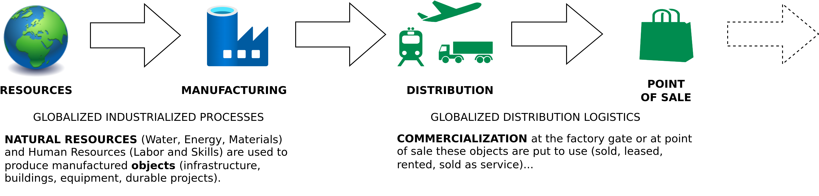
Sustainability
The Linear (Industrial) Economy
Image adapted from: Walter R. Stahel (2019) – The Circular Economy: A User’s Guide.

Slide 27
A Lack of Resources

Slide 28
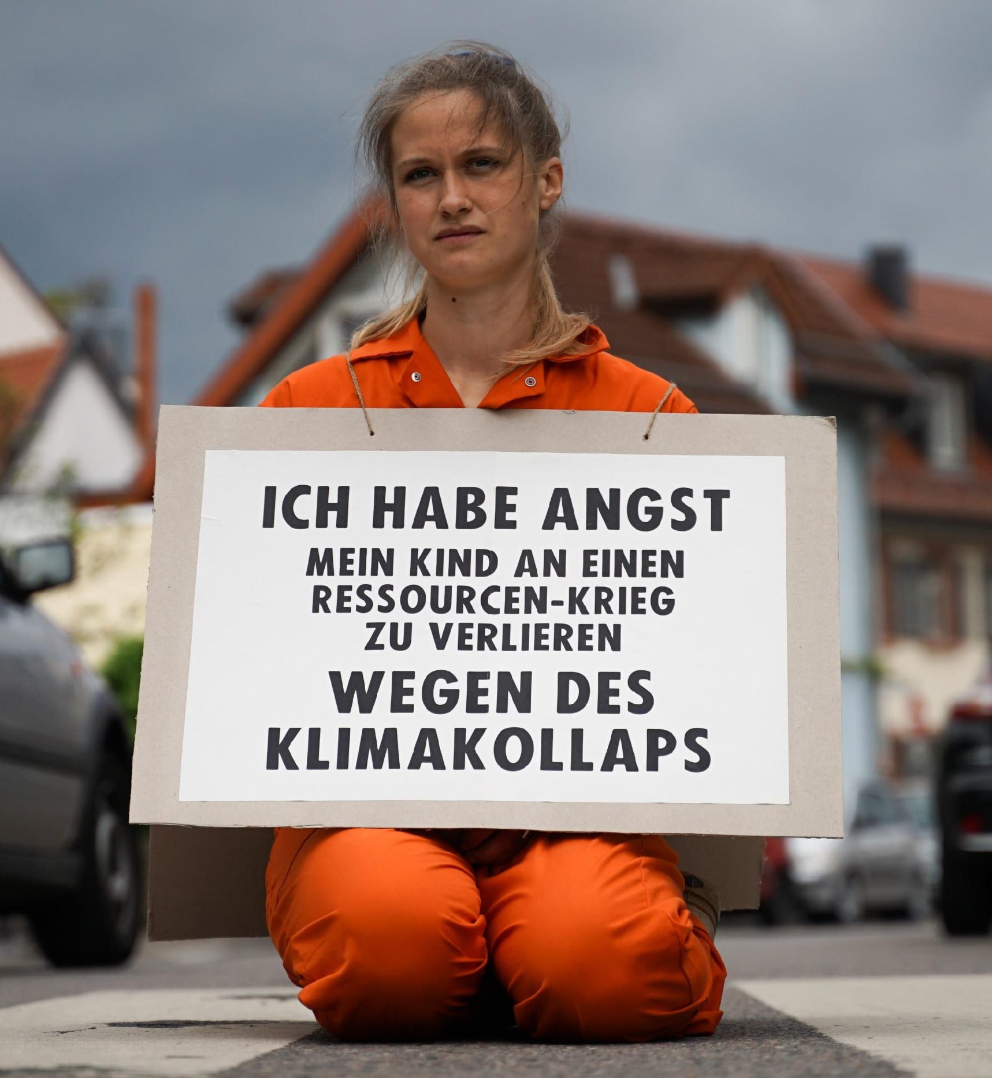
We only have one planet
Resources
“I am afraid of losing my child to a resource war because of a climate collapse”
→ “Our parents will die of old age, our children will die of climate change”
XR Strategiepapier 2022 – Pusteblumen und Hype. Bilder: Sebastian Höhn, Joe Pohl, Sandra Doneck, Alessandro Brönnimann

Slide 29
We only have one Planet
Resource Wars
“Resource wars are violent conflicts that are largely driven by competition for control over vital or valuable natural materials, such as oil, water, land, timber, animals (or animal products), gold, silver, gems, and other key minerals.”
Michael T. Klare, Barry S. Levy, Victor W. Sidel (2011) – The Public Health Implications of Resource Wars – Link.

Slide 30
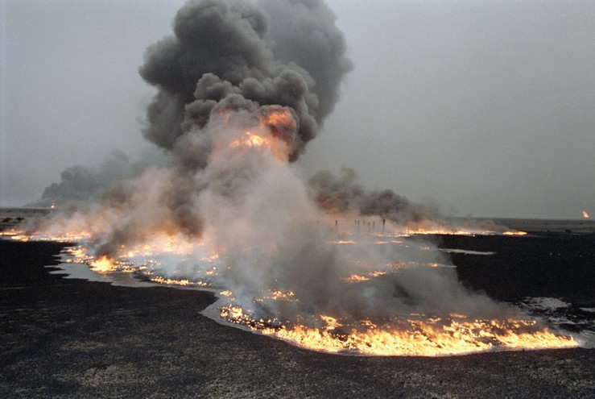
We only have one Planet
Resource Wars – Oil, etc.
United Nations Photo – https://www.flickr.com/photos/un_photo/5559102272 – CC BY-NC-ND 2.0.

Slide 31
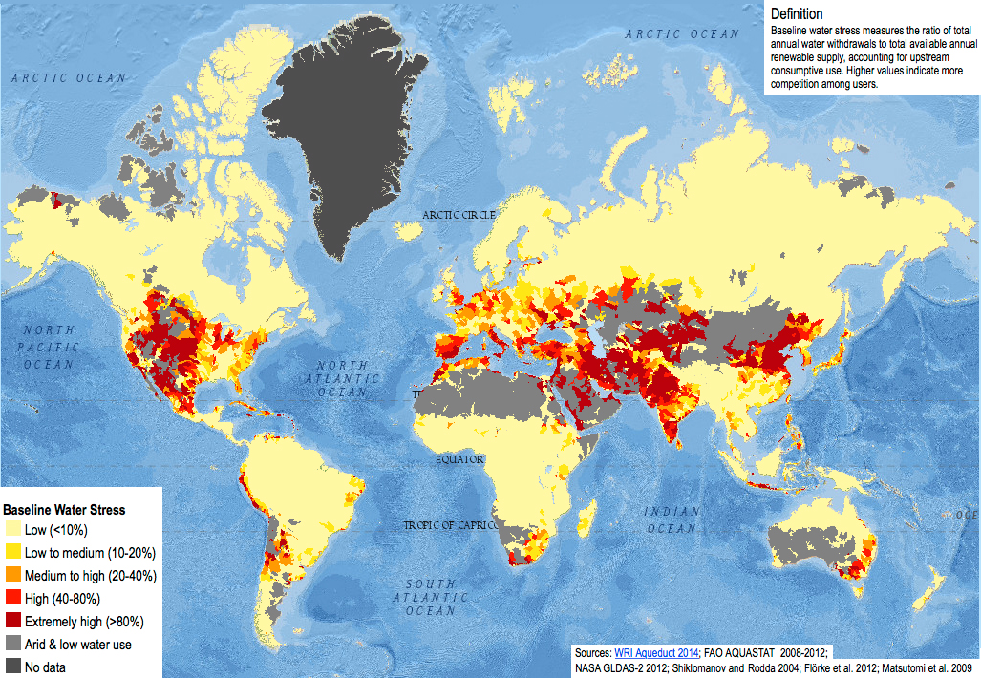
We only have one Planet
Resource Wars – Water
1. Sampa – https://commons.wikimedia.org/wiki/File:Baseline_water_stress.jpg – CC BY-SA 4.0.
2. Kgbo – https://commons.wikimedia.org/wiki/File:Closed_Wivenhoe_Dam_and_spillway,_August_2020.jpg – CC BY-SA 4.0.
3.Arian Zwegers – https://www.flickr.com/photos/azwegers/6226842732 – CC BY 2.0.

Slide 32
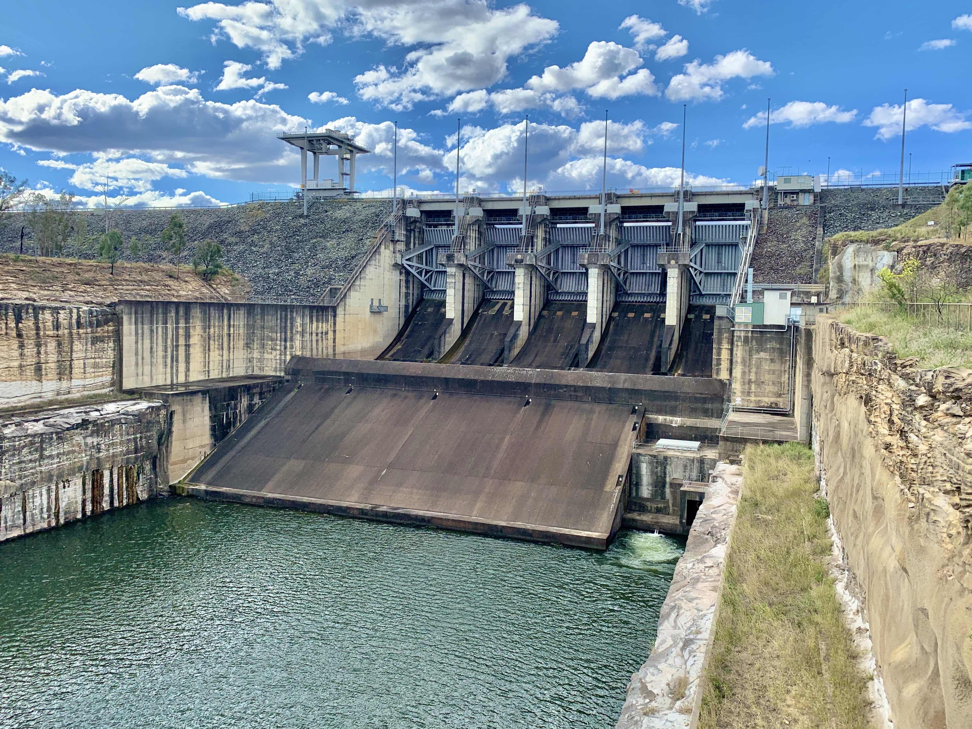
We only have one Planet
Resource Wars – Water
1. Sampa – https://commons.wikimedia.org/wiki/File:Baseline_water_stress.jpg – CC BY-SA 4.0.
2. Kgbo – https://commons.wikimedia.org/wiki/File:Closed_Wivenhoe_Dam_and_spillway,_August_2020.jpg – CC BY-SA 4.0.
3.Arian Zwegers – https://www.flickr.com/photos/azwegers/6226842732 – CC BY 2.0.

Slide 33
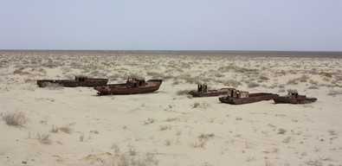
We only have one Planet
Resource Wars – Water
1. Sampa – https://commons.wikimedia.org/wiki/File:Baseline_water_stress.jpg – CC BY-SA 4.0.
2. Kgbo – https://commons.wikimedia.org/wiki/File:Closed_Wivenhoe_Dam_and_spillway,_August_2020.jpg – CC BY-SA 4.0.
3.Arian Zwegers – https://www.flickr.com/photos/azwegers/6226842732 – CC BY 2.0.

Slide 34
Environmental Pollution

Slide 35
Environmental Pollution
Definition
„Pollution, also called environmental pollution, the addition of any substance (solid, liquid, or gas) or any form of energy (such as heat, sound, or radioactivity) to the environment at a rate faster than it can be dispersed, diluted, decomposed, recycled, or stored in some harmless form.
The major kinds of pollution, usually classified by environment, are air pollution, water pollution, and land pollution.”
Nathanson, Jerry A.. "pollution". Encyclopedia Britannica, 22 Feb. 2022, https://www.britannica.com/science/pollution-environment. Accessed 11 April 2022.

Slide 36
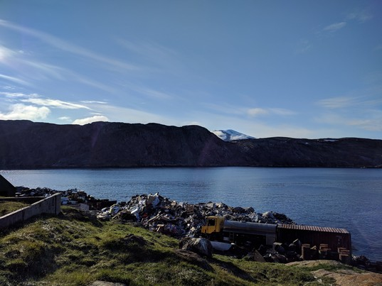
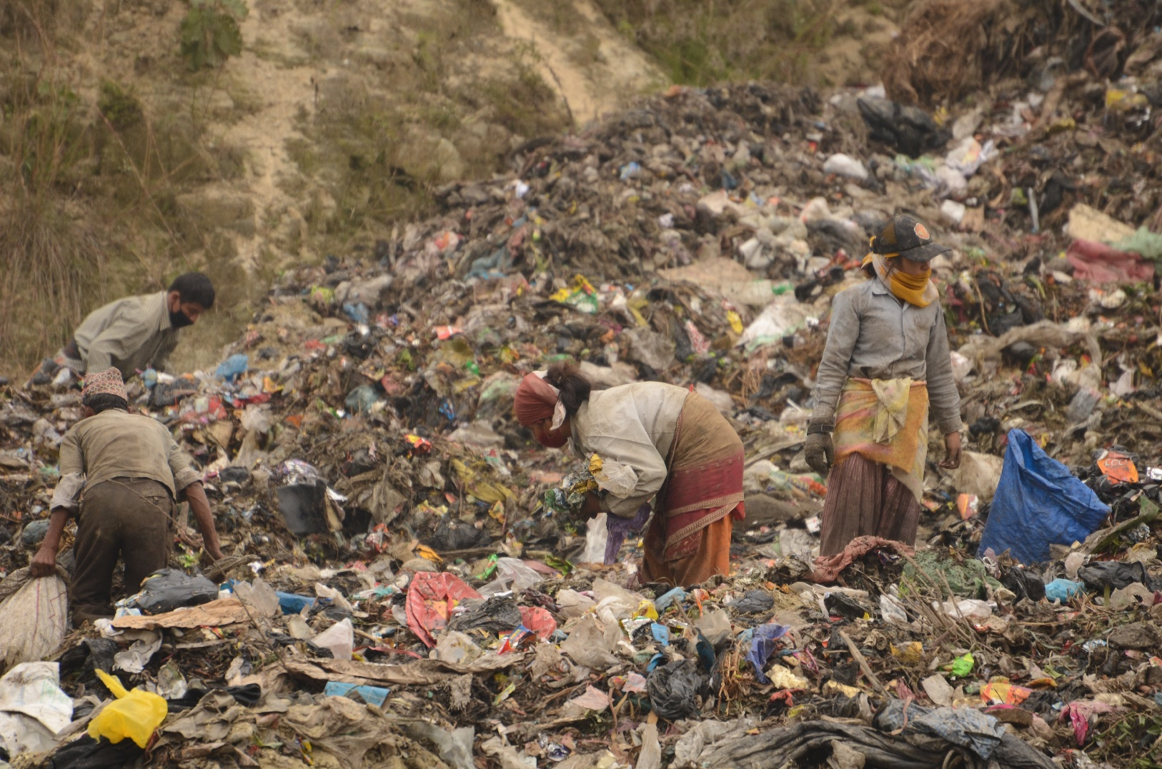
Environmental Pollution
Waste
1. "Landfill at Upernavik" by ulalume – https://www.flickr.com/photos/96649248@N00/43867280734 – CC BY-NC-ND 2.0.
2. Christian Hüpfer – https://flic.kr/p/aKXw2F – CC BY-SA 2.0.

Slide 37
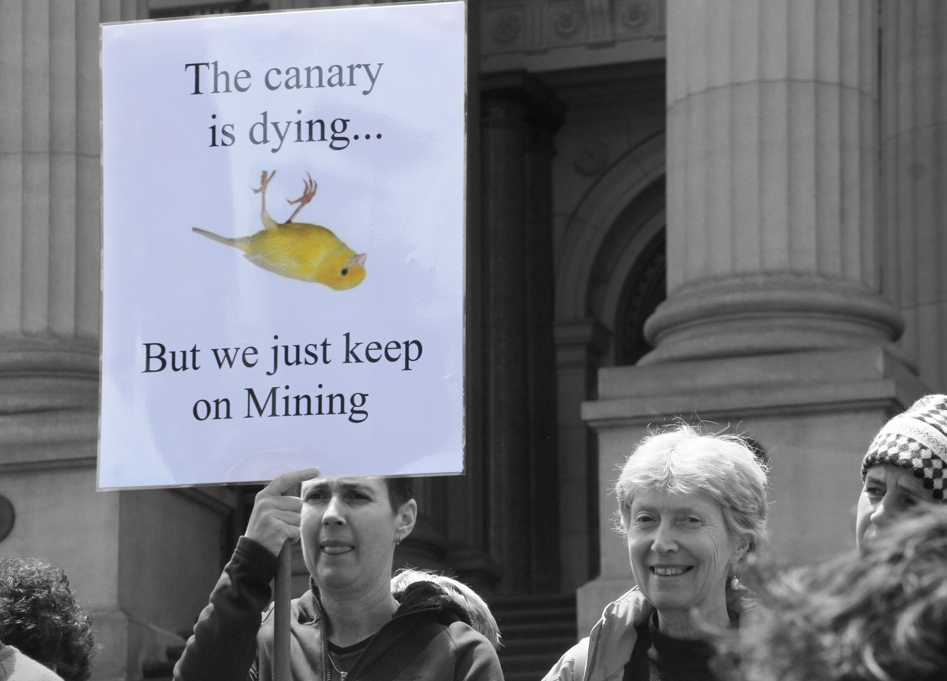
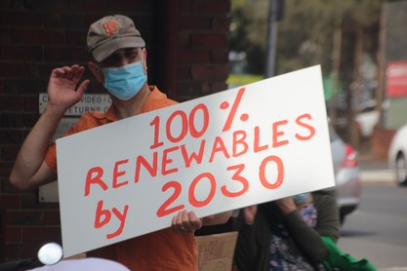
Environmental Pollution
Fossil Fuels
3 of the 10 dirtiest European coal plants are located in Poland
In which country/countries are the other 7 dirtiest coal plants located?
7 of the 10 dirtiest European coal plants are located in GERMANY
1. https://ember-climate.org/insights/research/top-10-emitters-in-the-eu-ets-2021/
2. John Englart – https://www.flickr.com/photos/takver/11308053925/ – CC BY-SA 2.0.
3. John Englart – https://www.flickr.com/photos/takver/51658831095/ – CC BY-SA 2.0.

Slide 38
Environmental Pollution
Linear Economy – Definition

Slide 39
Environmental Pollution
Linear Economy – Definition
“Take – Make – Dispose”

Slide 40
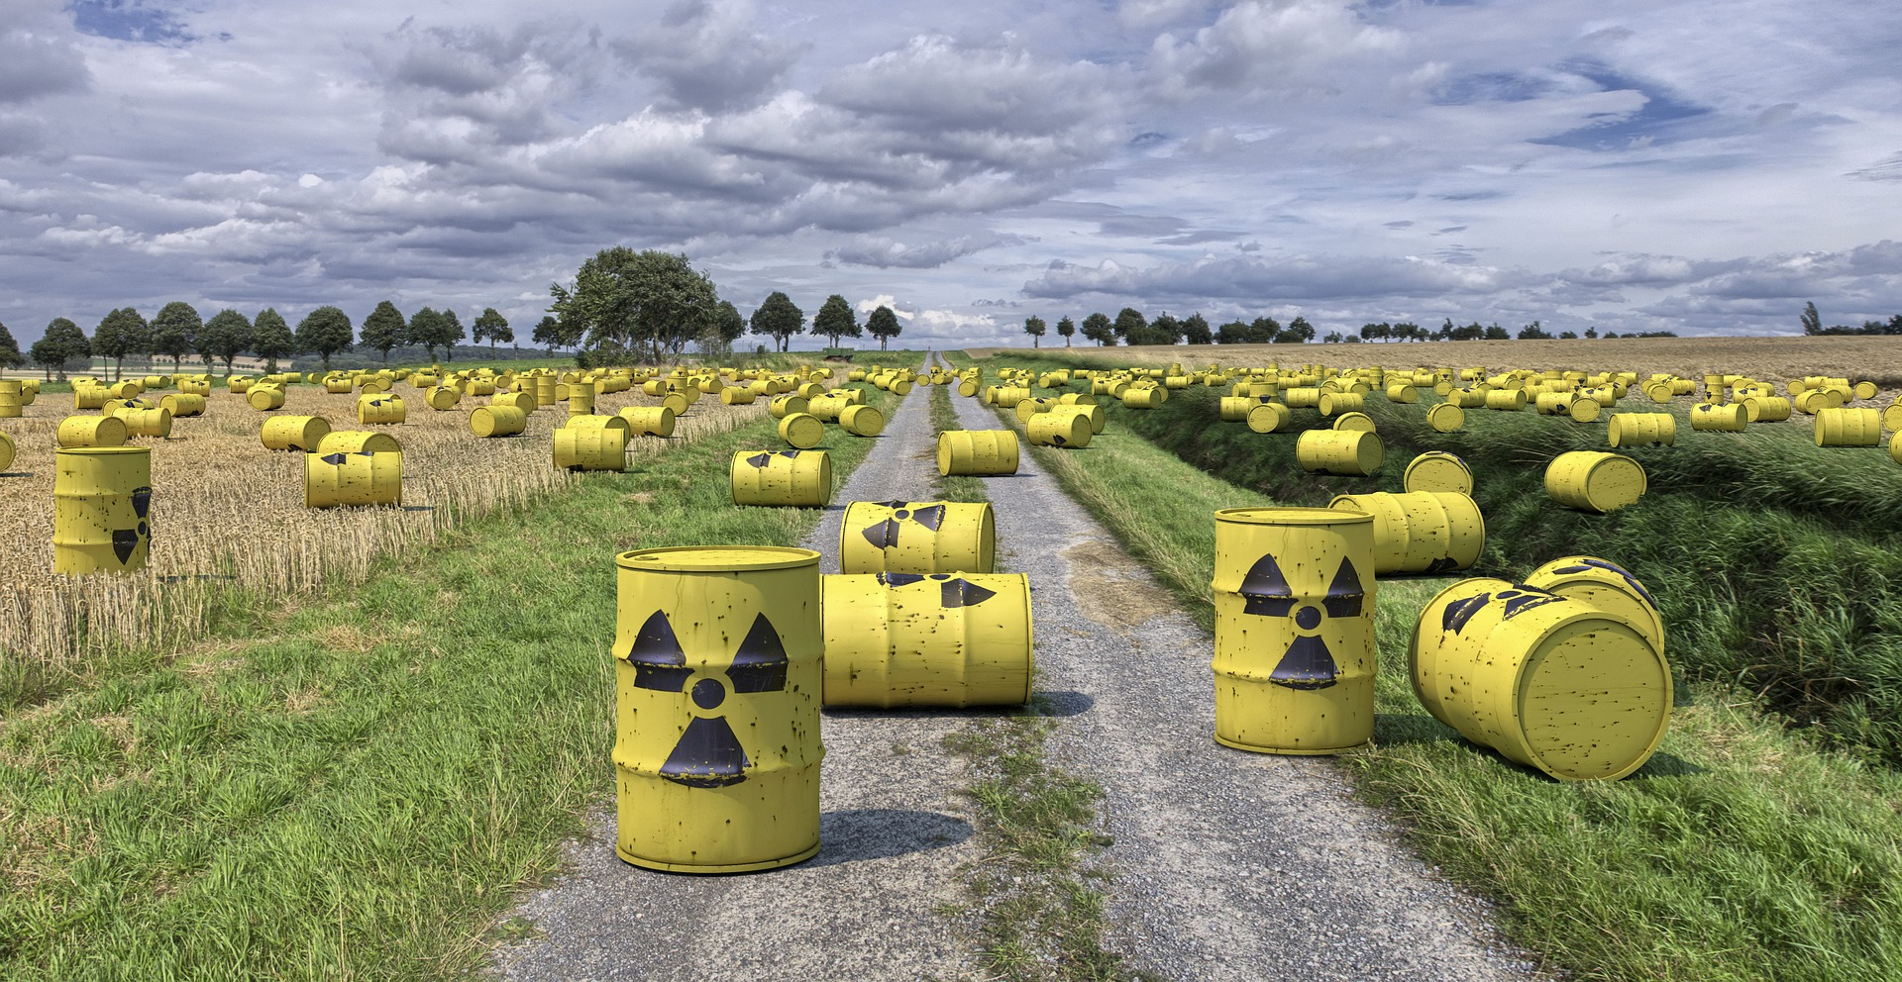
Environmental Pollution
Horrible Waste Management – Example 1

Slide 41
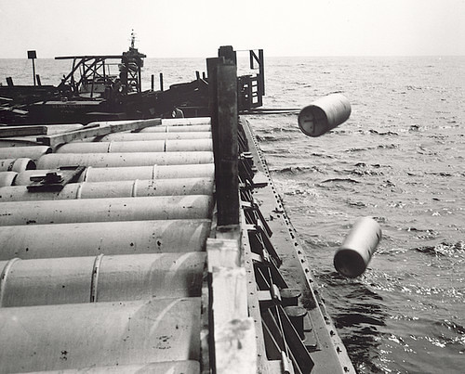
Environmental Pollution
Horrible Waste Management – Example 1
"Nuclear waste" by aaadrian365 is licensed with CC BY-NC 2.0. To view a copy of this license, visit https://creativecommons.org/licenses/by-nc/2.0/

Slide 42
Environmental Pollution
Horrible Waste Management – Example 1
→ 40,000 generations will have to live with the waste
→ 2 generations profited from cheap nuclear energy
https://www.spiegel.de/wissenschaft/technik/endlager-suche-was-wie-viel-und-wohin-damit-die-deutsche-atommuell-bilanz-a-7a153ba3-029a-4e55-adaf-3312b7427d9e

Slide 43
Environmental Pollution
Horrible Waste Management – Example 1
→ 40,000 generations will have to live with the waste
→ 2 generations profited from cheap nuclear energy
→ 40,000 generation will have to live with the waste
https://www.spiegel.de/wissenschaft/technik/endlager-suche-was-wie-viel-und-wohin-damit-die-deutsche-atommuell-bilanz-a-7a153ba3-029a-4e55-adaf-3312b7427d9e

Slide 44
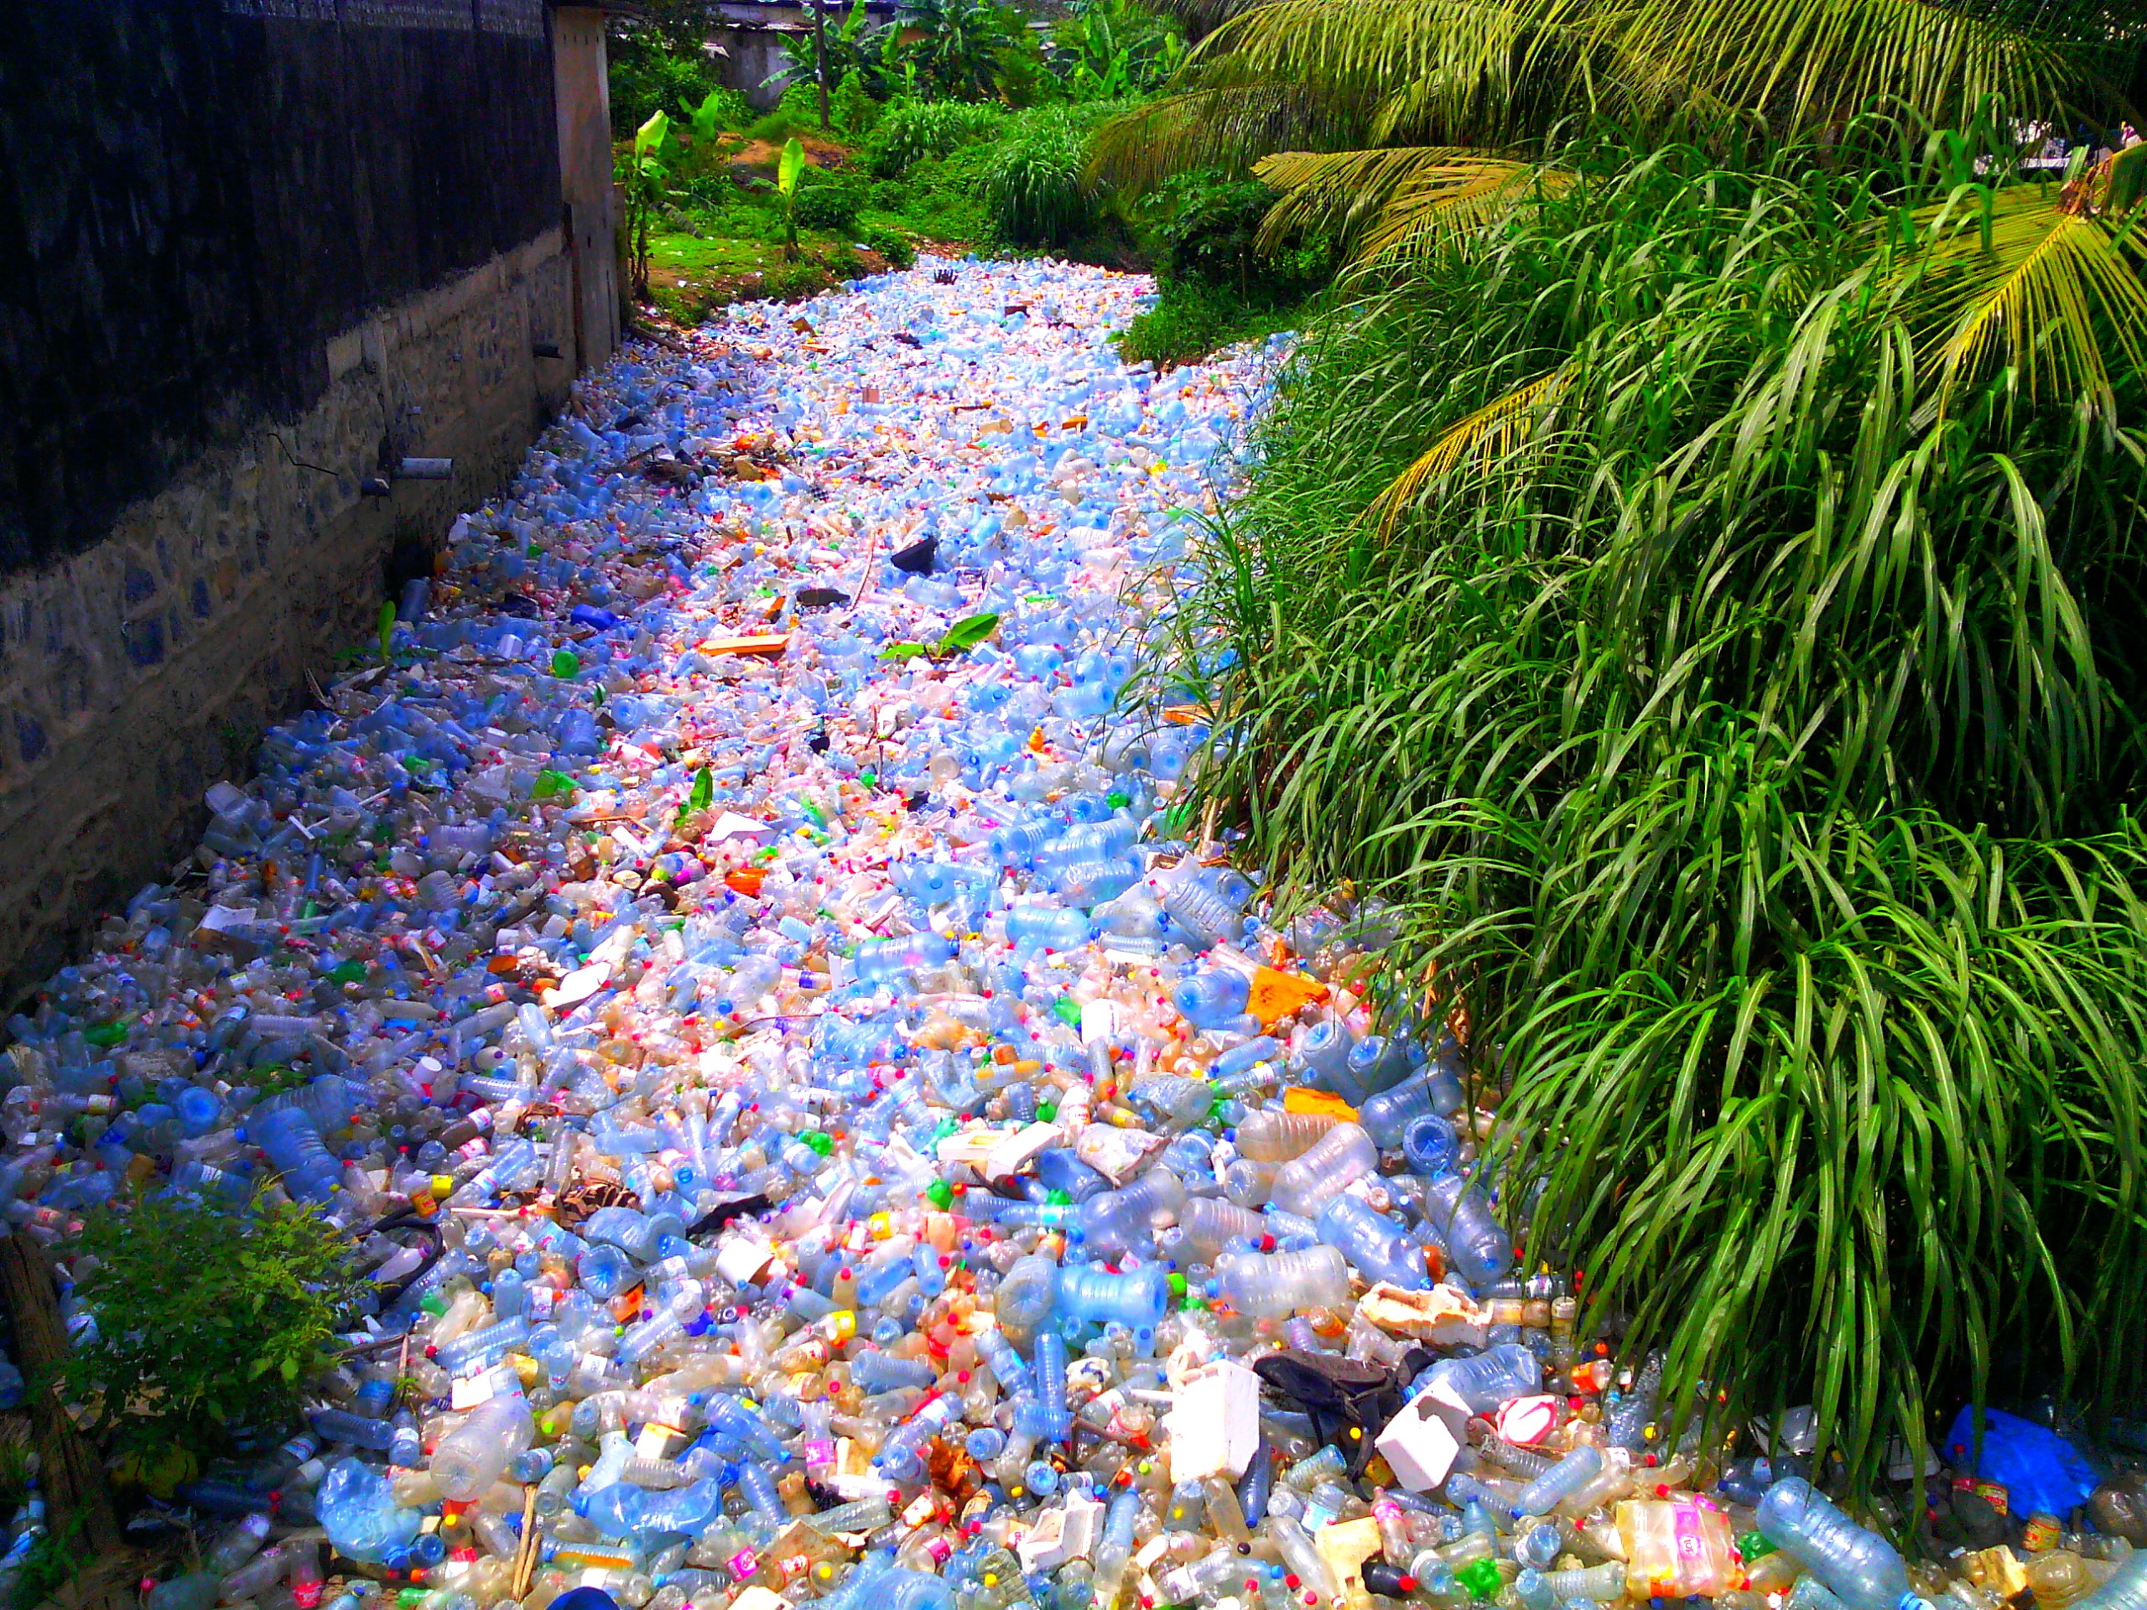
Environmental Pollution
Horrible Waste Management – Example 2
"Pollution Plastique" by Mouenthias is licensed with CC BY-SA 4.0. To view a copy of this license, visit https://creativecommons.org/licenses/by-sa/4.0/

Slide 45
Environmental Pollution
Horrible Waste Management – Example 2
We are consuming about 2000 tiny pieces of plastic every week.
That is a credit card every week!
That’s approximately 21 grams a month, or just over 250 grams a year.
"Pollution Plastique" by Mouenthias is licensed with CC BY-SA 4.0. To view a copy of this license, visit https://creativecommons.org/licenses/by-sa/4.0/
Wijnand de Wit and Nathan Bigaud for the WWF (2019) – No Plastic in Nature: Assessing Plastic Ingestion from Nature to People.

Slide 46
Environmental Pollution
Horrible Waste Management – Example 2
We are consuming about 2000 tiny pieces of plastic every week.
That is a credit card every week!
That’s approximately 21 grams a month, or just over 250 grams a year.
"Pollution Plastique" by Mouenthias is licensed with CC BY-SA 4.0. To view a copy of this license, visit https://creativecommons.org/licenses/by-sa/4.0/
Wijnand de Wit and Nathan Bigaud for the WWF (2019) – No Plastic in Nature: Assessing Plastic Ingestion from Nature to People.

Slide 47
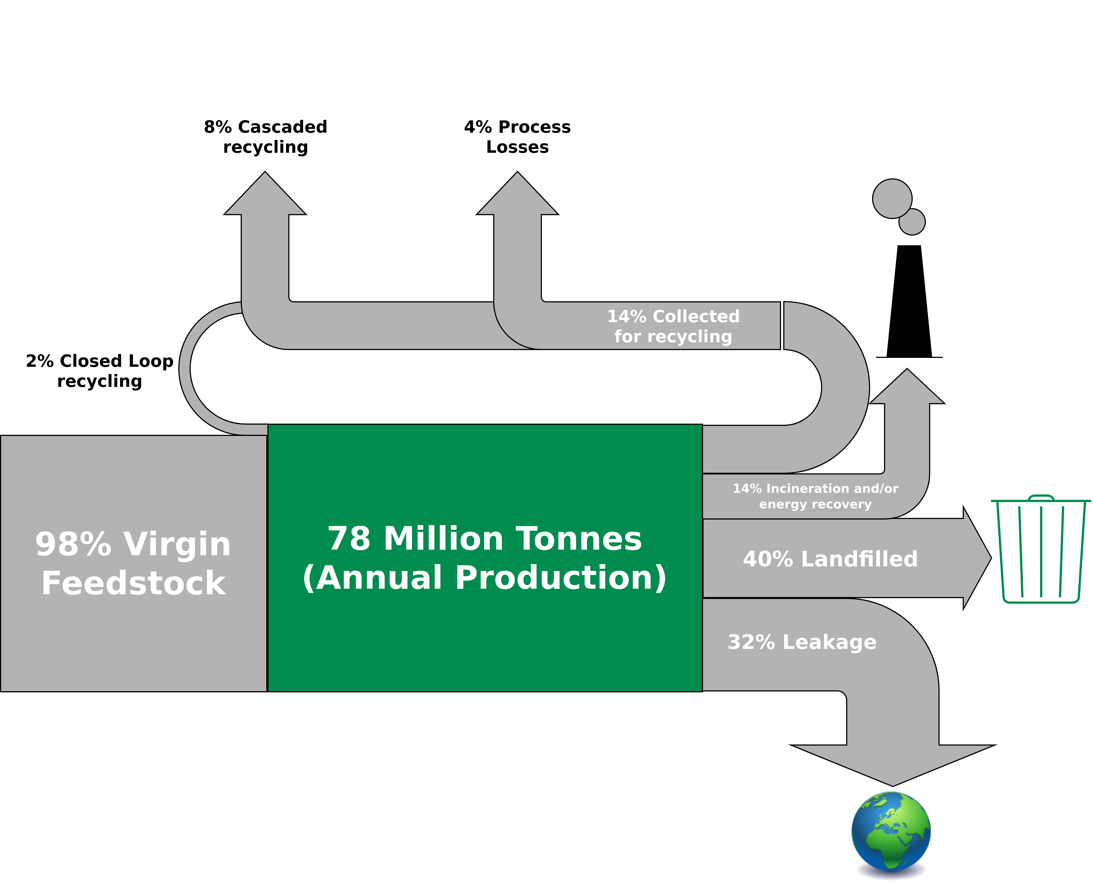
Environmental Pollution
Global Flows of Plastic Packaging Materials in 2013
Figure adapted from: Ellen MacArthur Foundation (2016) – THE NEW PLASTICS ECONOMY

Slide 48
Environmental Pollution
Global Flows of Plastic Packaging Materials in 2013
In 2050, there will be more plastic than fish in the ocean (by weight) is a credit card every week!
That’s approximately 21 grams a month, or just over 250 grams a year.
Figure adapted from: Ellen MacArthur Foundation (2016) – THE NEW PLASTICS ECONOMY

Slide 49
Environmental Pollution
The Limits to Recycling
Recycling often requires a lot of energy
Some materials cannot be recycled at all (yet)
Impurities are challenging
Often requires a lot of manual labor
Recycled material often with lower quality than input material
False sense of safety!
I am not saying you should stop recycling!
→ Recycling is great but it is better to make sure that we do not have to recycle anything.
→ Buying less (only the essentials) is way more effective than recycling.

Slide 50
Environmental Pollution
The Limits to Recycling
Recycling often requires a lot of energy
Some materials cannot be recycled at all (yet)
Impurities are challenging
Often requires a lot of manual labor
Recycled material often with lower quality than input material
False sense of safety!
I am not saying you should stop recycling!
→ Recycling is great but it is better to make sure that we do not have to recycle anything.
→ Buying less (only the essentials) is way more effective than recycling.

Slide 51
Environmental Pollution
The Limits to Recycling
Recycling often requires a lot of energy
Some materials cannot be recycled at all (yet)
Impurities are challenging
Often requires a lot of manual labor
Recycled material often with lower quality than input material
False sense of safety!
I am not saying you should stop recycling!
→ Recycling is great but it is better to make sure that we do not have to recycle anything.
→ Buying less (e.g., only the essentials) is way more effective.
“We buy things we don't need, to impress people we don't like.” - Tyler Durden / Chuck Palahniuk

Slide 52
Conclusion

Slide 53
Conclusion
Personal carbon footprint and greenwashing
Basic concepts and definitions related to sustainability, resources, environmental pollution
The limits to recycling
Exercise E02
Q&A teaser → Case study on avoiding food waste

Slide 54
Exercise E02

Slide 55
Exercise E02
Household Waste
Get the largest jar that you can find (either at your own place, or ask your friends).
Collect all the trash that you are producing in the upcoming week (except for bio-waste that is supposed to go into the green trash bin) – starting on Tuesday (10.05.2022 – 00:01) until Sunday (15.05.2022 – 23:59).
How many days of trash can you fit into your jar?
Submit your result according to the submission guidelines posted in the exercise sheet → E02.

Slide 56
Additional Resources
Baccini et al. (2012) – Metabolism of the Anthroposphere: Analysis, Evaluation, Design
Podcast How to Save a Planet – “Sacrifice Zones: ProPublica Takes Us Inside America’s Toxic Hotspots (2022) – Link

Slide 57
Questions?

Slide 58
Case Study: Foodsharing.de

Slide 59
The Problem
Food Waste – Overview (2015)
1.3 billion tons of the world's food ends up in the trash every year.
In Germany alone, 12 million tons of food are wasted every year → per capita: 75kg/year
Private households → 6.7 million tons (52%)
Processing → 2.2 million tons (18%)
Out-of-home-consumption → 1.7 million tons (14%)
Primary production → 1.4 million tons (12%)
Retail → 0.5 million tons (4%)
1.) BMEL (2021) – Lebensmittelabfälle in Deutschland: Aktelle Studie über Höhe der Lebensmittelabfälle nach Sektoren – https://www.bmel.de/DE/themen/ernaehrung/lebensmittelverschwendung/studie-lebensmittelabfaelle-deutschland.html
2.) Lebensmittelabfälle in Deutschland – Baseline 2015 (2019) – https://www.thuenen.de/media/publikationen/thuenen-report/Thuenen_Report_71.pdf

Slide 60
The Problem
Food Waste – Overview (2015)
1.3 billion tons of the world's food ends up in the trash every year.
In Germany alone, 12 million tons of food are wasted every year → per capita: 75kg/year
Private households → 6.7 million tons (52%)
Processing → 2.2 million tons (18%)
Out-of-home-consumption → 1.7 million tons (14%)
Primary production → 1.4 million tons (12%)
Retail → 0.5 million tons (4%)
1.) BMEL (2021) – Lebensmittelabfälle in Deutschland: Aktelle Studie über Höhe der Lebensmittelabfälle nach Sektoren – https://www.bmel.de/DE/themen/ernaehrung/lebensmittelverschwendung/studie-lebensmittelabfaelle-deutschland.html
2.) Lebensmittelabfälle in Deutschland – Baseline 2015 (2019) – https://www.thuenen.de/media/publikationen/thuenen-report/Thuenen_Report_71.pdf

Slide 61
The Problem
Food Waste – Retail in more detail (2015)
Total food waste → 696,484 tons
Fruit and vegetables → 328,245 tons
Bread and baked goods → 206,399 tons
Dairy products → 60,255 tons
Meat-like/based products → 53,307 tons
Others → 48,279 tons
Where is the difference between the 0.5 million tons on the previous slide and the 696,484 tons on this slide coming from? → donated food (Tafel Deutschland e.V.)
1.) BMEL (2021) – Lebensmittelabfälle in Deutschland: Aktelle Studie über Höhe der Lebensmittelabfälle nach Sektoren – https://www.bmel.de/DE/themen/ernaehrung/lebensmittelverschwendung/studie-lebensmittelabfaelle-deutschland.html
2.) Lebensmittelabfälle in Deutschland – Baseline 2015 (2019) – https://www.thuenen.de/media/publikationen/thuenen-report/Thuenen_Report_71.pdf

Slide 62
The Problem
Food Waste – Retail in more detail (2015)
Total food waste → 696,484 tons
Fruit and vegetables → 328,245 tons
Bread and baked goods → 206,399 tons
Dairy products → 60,255 tons
Meat-like/based products → 53,307 tons
Others → 48,279 tons
Where is the difference between the 0.5 million tons on the previous slide and the 696,484 tons on this slide coming from? → donated food (Tafel Deutschland e.V.)
1.) BMEL (2021) – Lebensmittelabfälle in Deutschland: Aktelle Studie über Höhe der Lebensmittelabfälle nach Sektoren – https://www.bmel.de/DE/themen/ernaehrung/lebensmittelverschwendung/studie-lebensmittelabfaelle-deutschland.html
2.) Lebensmittelabfälle in Deutschland – Baseline 2015 (2019) – https://www.thuenen.de/media/publikationen/thuenen-report/Thuenen_Report_71.pdf

Slide 63
The Problem
Food Waste – Retail in more detail (2015)
Total food waste → 696,484 tons
Fruit and vegetables → 328,245 tons
Bread and baked goods → 206,399 tons
Dairy products → 60,255 tons
Meat-like/based products → 53,307 tons
Others → 48,279 tons
Where is the difference between the 0.5 million tons on the previous slide and the 696,484 tons on this slide coming from? → donated food (Tafel Deutschland e.V.)
1.) BMEL (2021) – Lebensmittelabfälle in Deutschland: Aktelle Studie über Höhe der Lebensmittelabfälle nach Sektoren – https://www.bmel.de/DE/themen/ernaehrung/lebensmittelverschwendung/studie-lebensmittelabfaelle-deutschland.html
2.) Lebensmittelabfälle in Deutschland – Baseline 2015 (2019) – https://www.thuenen.de/media/publikationen/thuenen-report/Thuenen_Report_71.pdf

Slide 64
Solution?
General
Make it illegal to throw food away → In February 2016, France adopted a law on fighting food waste that meant supermarkets were forbidden to destroy unsold food products and were compelled to donate it instead.
Has been later adopted in the gastronomy and related sectors

Slide 65
Alternative Solutions?
Foodsharing Platform
Click Me
Platform launched in 2012
Decentralized and self-organized
450,000 registered user (all volunteers)
Cooperates with more than 11,000 businesses
More than 65 million tons of food saved
https://foodsharing.de/

Slide 66
Alternative Solutions?
Foodsharing Platform – How does it work?
Register (free – no charges, no subscriptions)
Types of users:
1. User
Share your own leftovers or collect food from others (offers visible on the Foodsharing map)
2. Foodsavers
Pass a quiz (quite some effort) and become a Foodsaver.
Allowed to collect (“save”) leftovers from businesses that cooperate with Foodsharing
Redistribute saved food among friends and within the Foodsharing community
3. Operations manager (Betriebsverantwortlicher = abbr. “BV”)
Manage cooperation with business, manage your team of Foodsavers and organize a collection schedule
https://foodsharing.de/

Slide 67
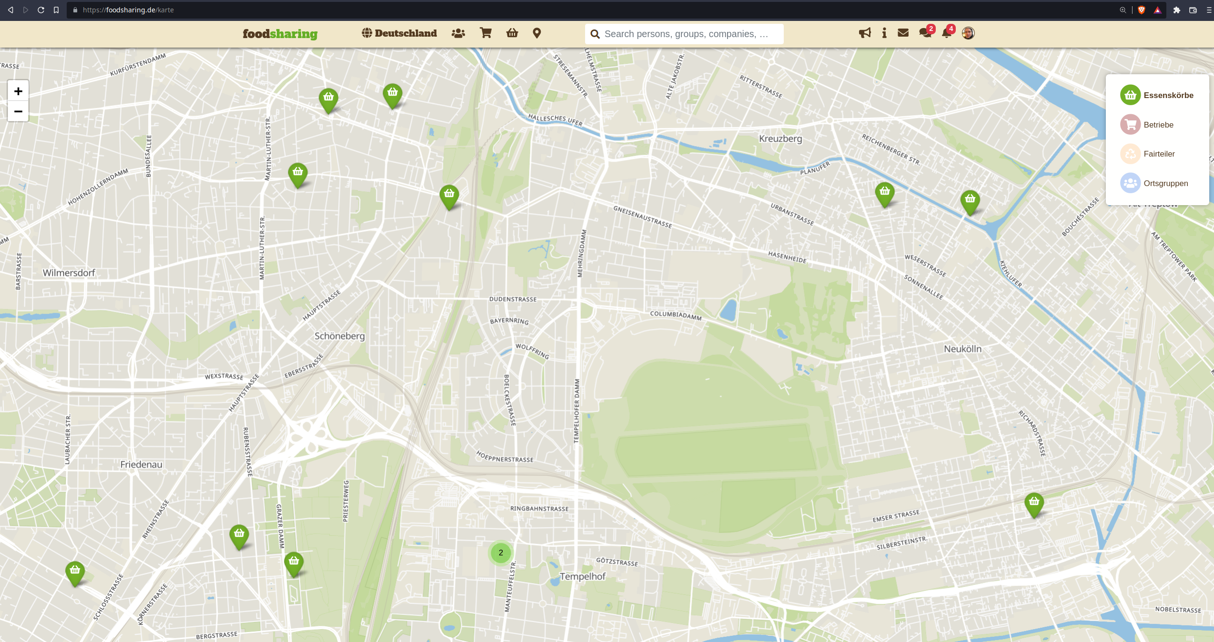
Alternative Solutions?
Foodsharing Platform – How does it work?
https://foodsharing.de/

Slide 68
Alternative Solutions?
Foodsharing Platform – How does it work?
Just keep/take what you can consume, redistribute everything else
Most businesses don’t want to be publicly mentioned
Bad image if you throw away huge amounts of food every day
People are supposed to buy their food at your place instead of picking it up for free ;)
Strict:
Food collection schedule (pre-defined time slots, each foodsaver only once every week or every two weeks, etc.)
Hygiene rules
Pre-defined procedures for collection of food
https://foodsharing.de/

Slide 69
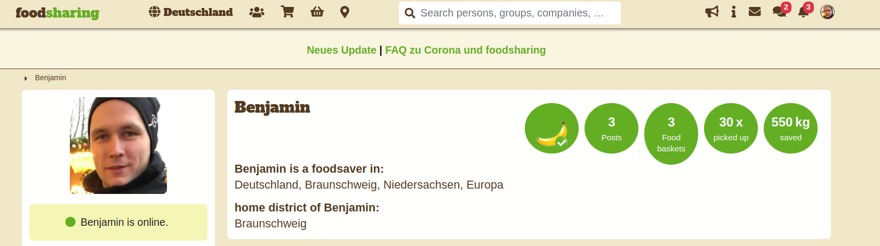
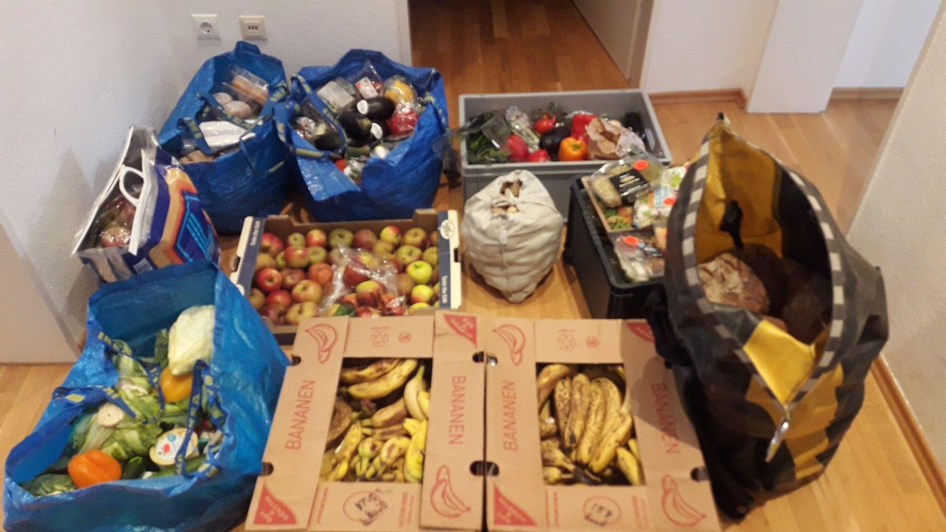
Alternative Solutions?
Foodsharing Platform – How much food is saved every day?
https://foodsharing.de/

Slide 70
Questions?

